Slide 1
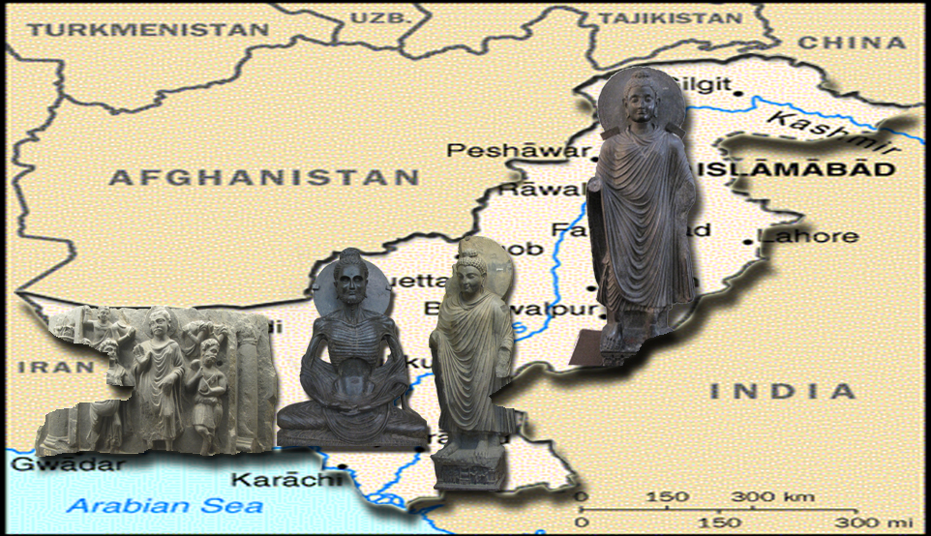
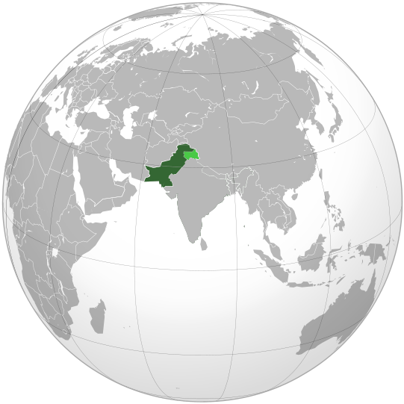
Six Decades of Thailand-Pakistan Friendship:
Towards Building a Strong Economic Partnership
PAKISTAN
Tourism in Pakistan: A Unique Buddhist Heritage
Venerable Phra Dr. Anil Sakya

Slide 2
The Buddhist Heritage of Pakistan

Slide 3
Taxila - Gandhara

Slide 4
Gandhararatha/Gandhararastra
Phra Gandhararastra พระคันธารราษฎร์ is enshrined in Wat Na Phra Meru in Ayutthaya.
The Buddha image is of the Dvaravati period (6-13 century). The size is 5.20 meter height and 1.70 meter width.
It is said that there are only 6 images of this type and 5 are in Thailand and 1 is in Indonesia.

Slide 5
Gandhararatha/Gandhararastra
Phra Gandhararastra was cast in 1783
Knee-to-knee width is 57.40 cm and
Height is 87.50 cm.
It is enshrined in the Gandhararastra shrine hall in the Emerald Buddha temple.

Slide 6
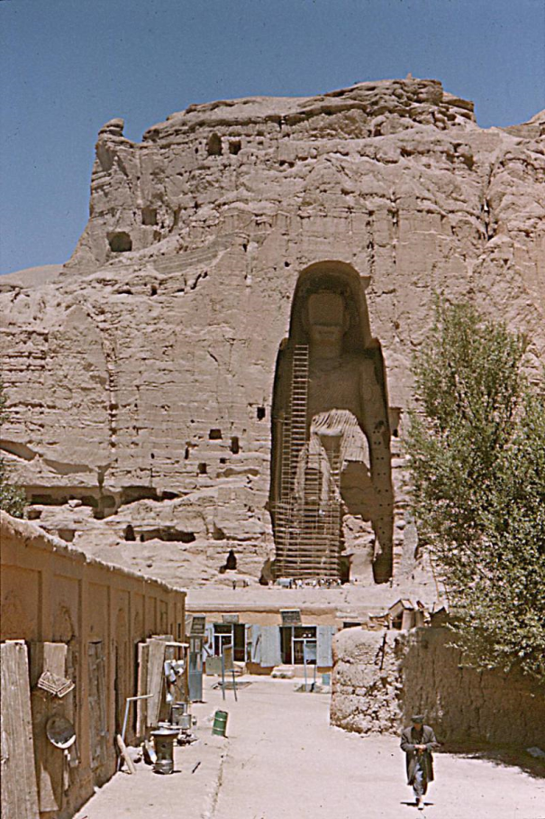
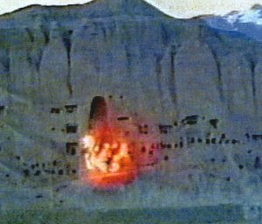
Bamiyan Buddha
March 2001

Slide 7
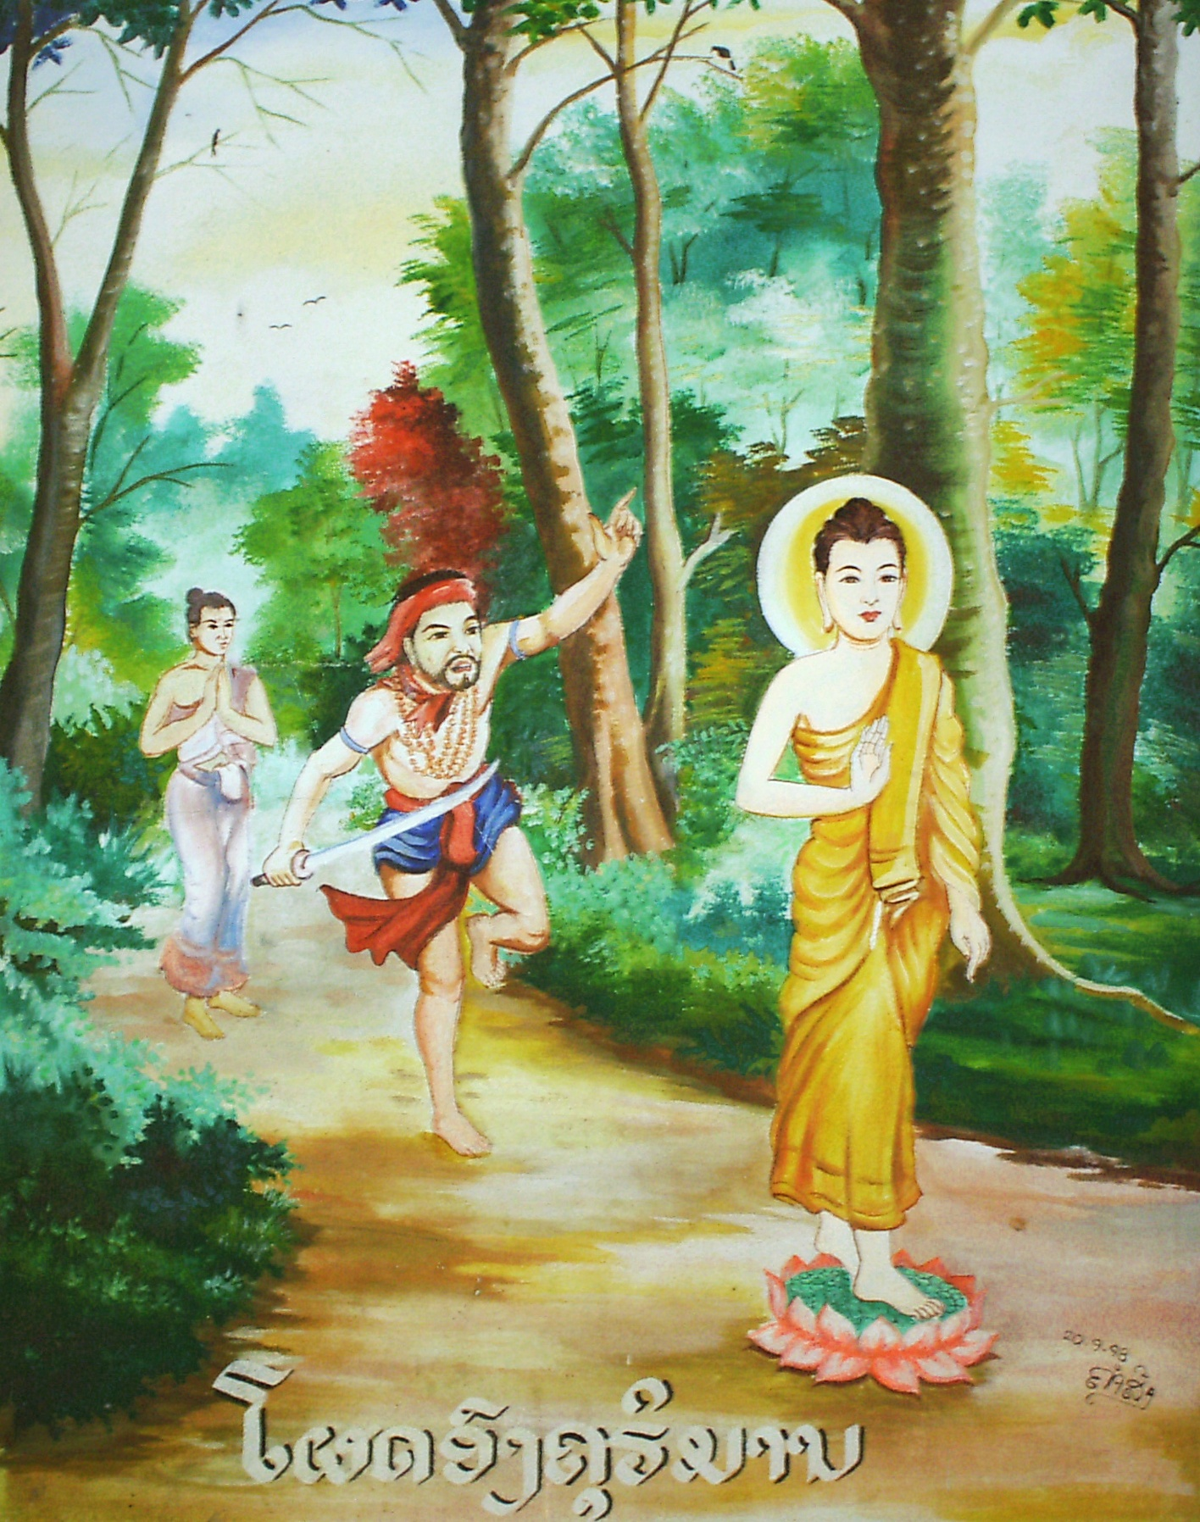
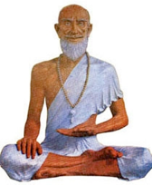
Taxila
Angulimala
Jivaka Komarabhacca

Slide 8
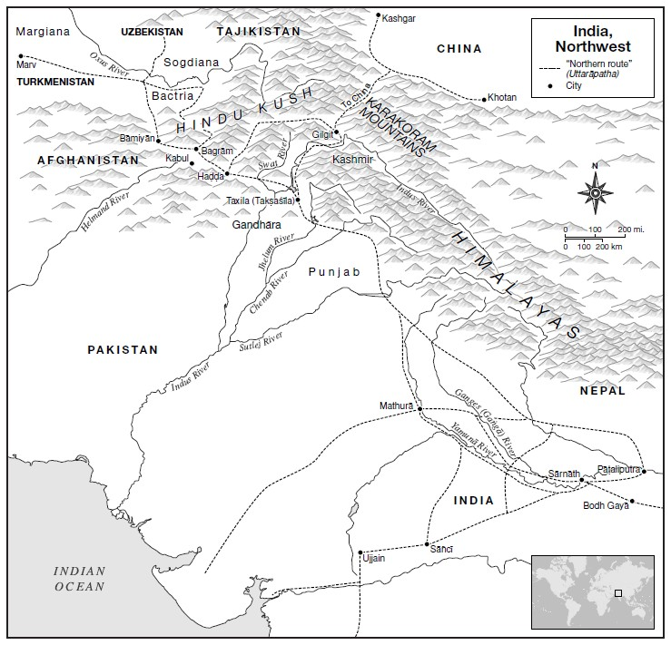
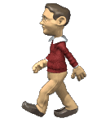
Uttarapatha :
the Northern Highway

Slide 9
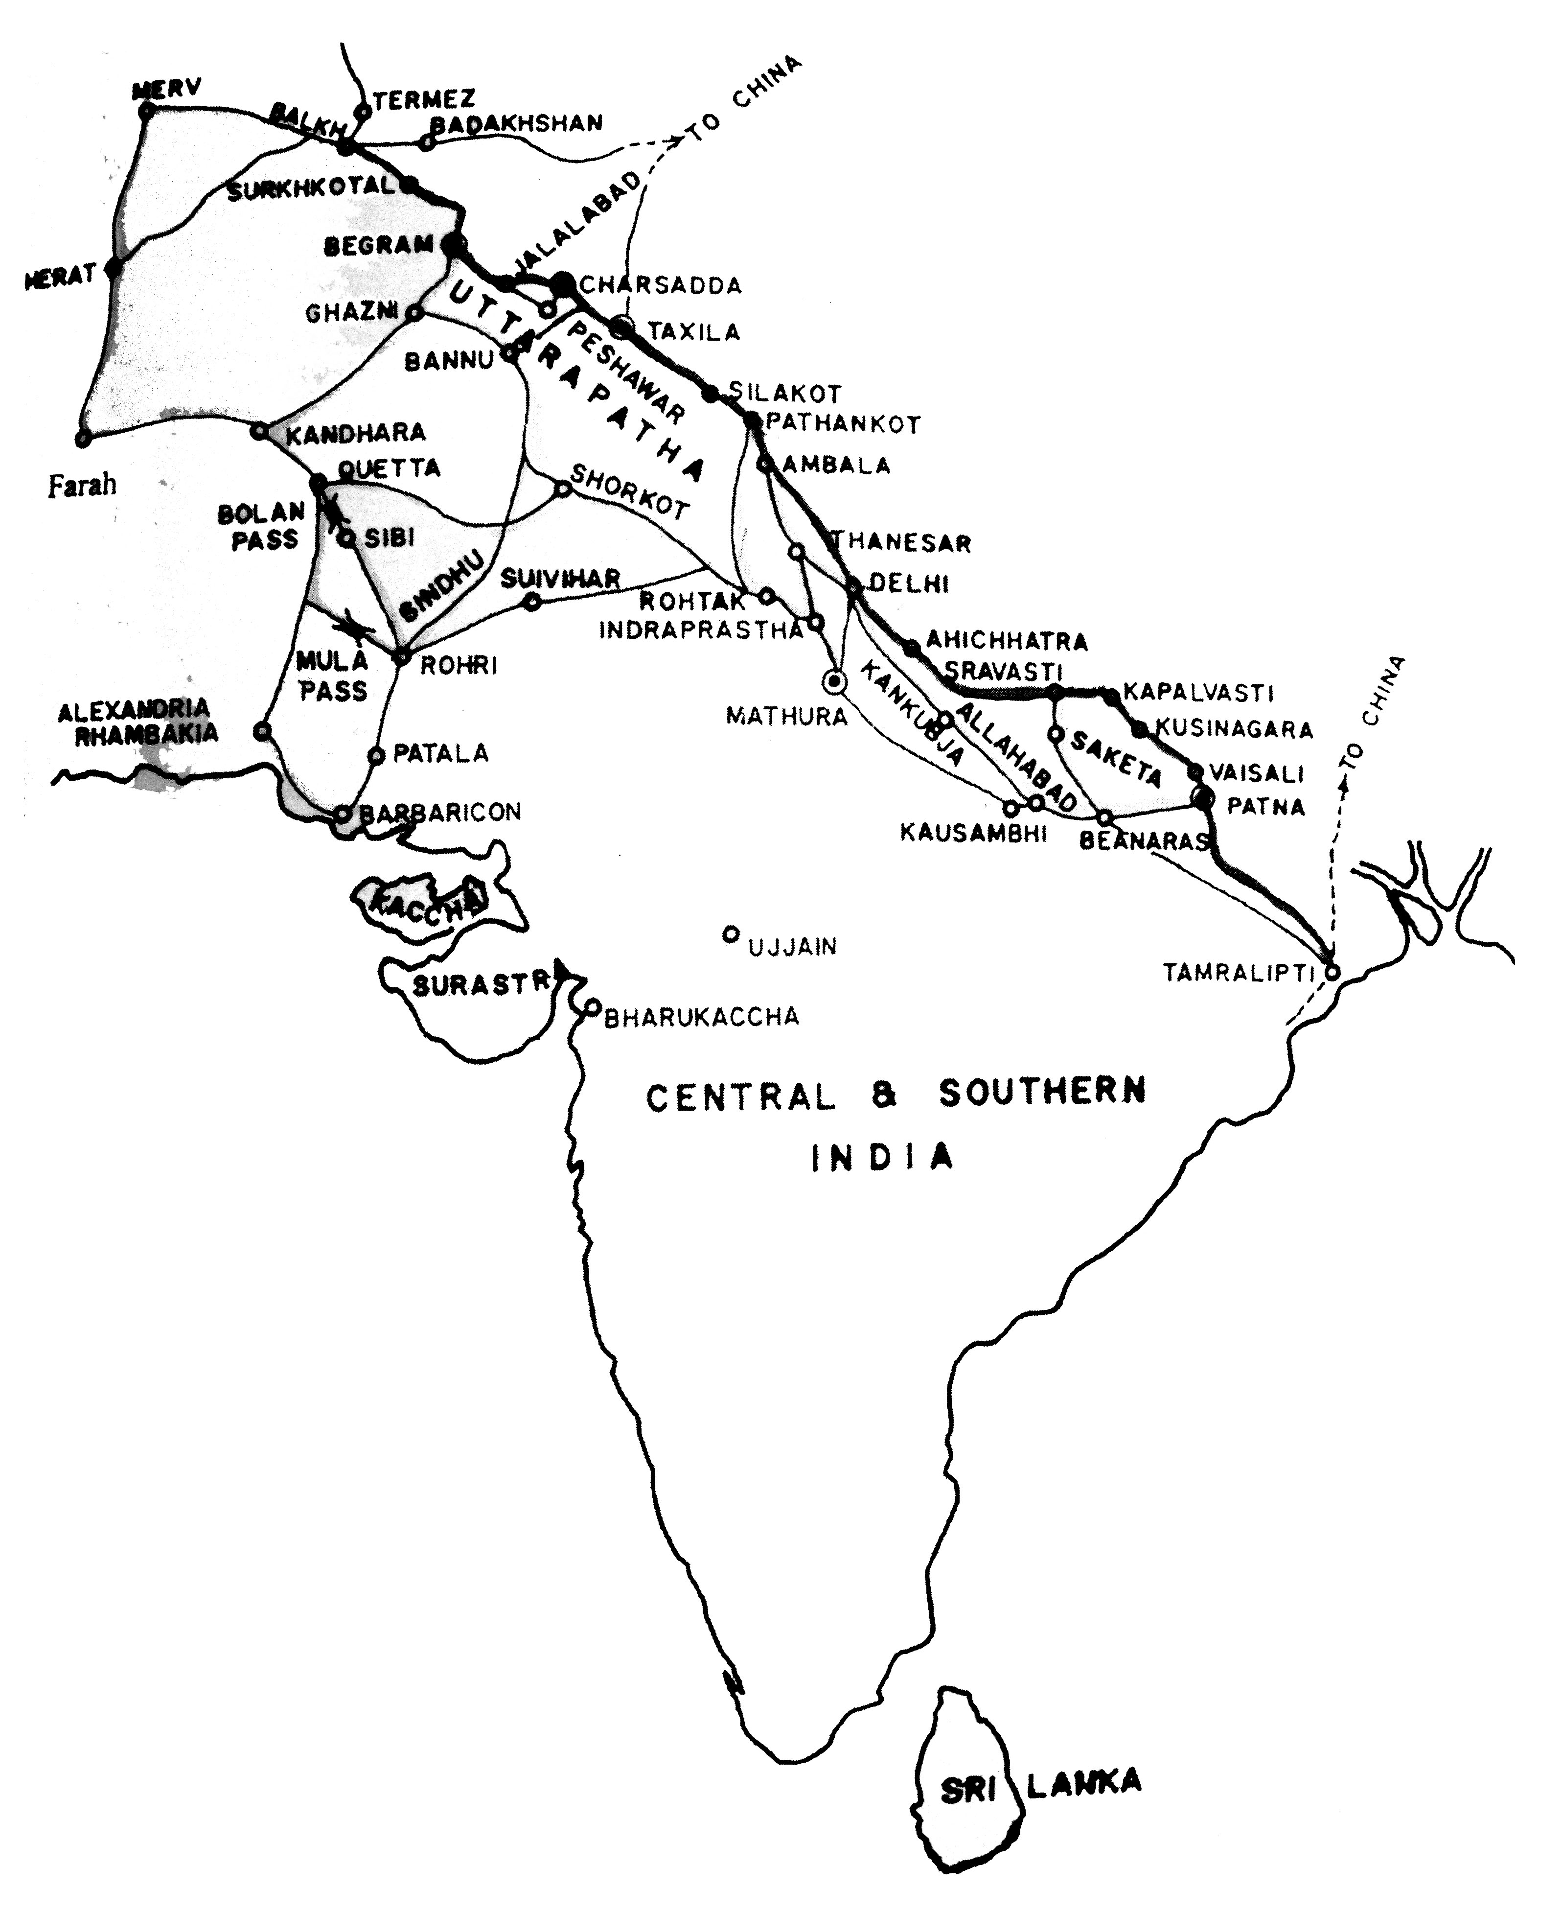
Uttarapatha-Northern Highway
Ancient Trade Route from the Buddha’s time

Slide 10
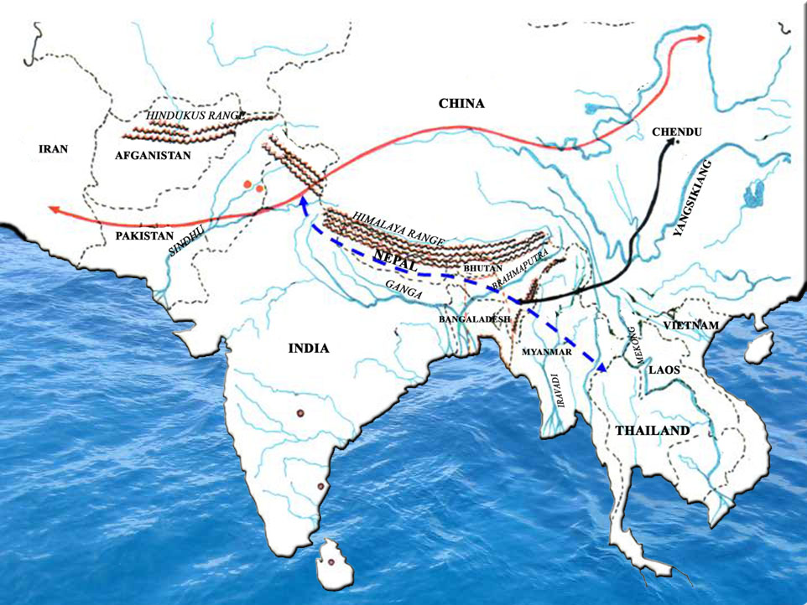
Kamboja –Dvaravati Caravan Route

Slide 11
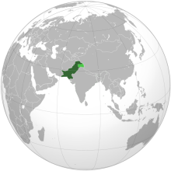
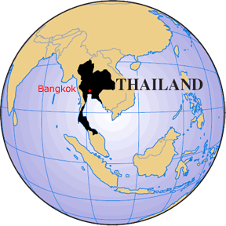
My visit to Pakistan

Slide 12
Gandhara Valley

Slide 13
Taxila Valley

Slide 14
Jaulian, Taxila

Slide 15
Dharmarajika, Taxila

Slide 16
Takht-e-Bahi Monastery, Swat

Slide 17
Takht-e-Bahi Monastery, Swat

Slide 18
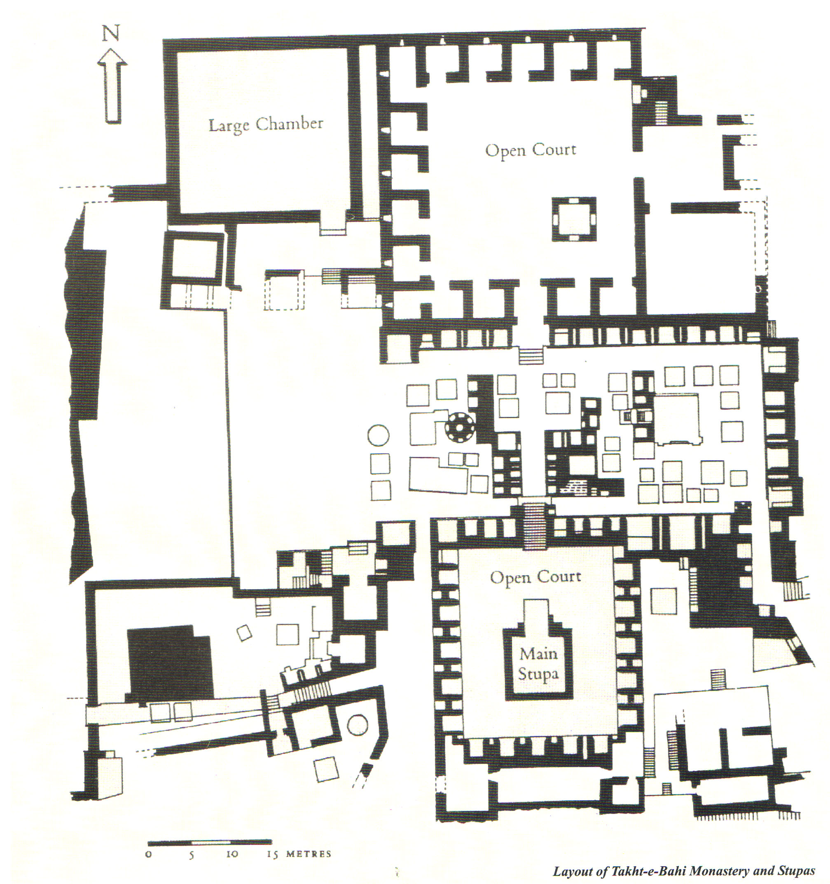
Takht-e-Bahi Monastery, Swat

Slide 19
The Buddhist Heritage of Pakistan

Slide 20
Historical Background
Gandhara under Achaemenid empire of Persia (600-400 BC.).
Invasion of Alexander the Great (326 BC.).
Mauryan Dynasty and spread of Buddhism in Gandhara (310-200 BC.).
Rule of Indo-Greeks and introduction of sculptural art in Gandhara (200 BC.-100 BC.)
Scythian Period (100-10 BC.)
Parthians conquer and rule Gandhara (10 BC.- 90 AD.)
Reign of Great Kushans, the Buddhist Art of Gandhara reaches to its climax. (90-465 AD.)
Invasion of White Huns and fall of Buddhism in Gandhara (465 AD.)

Slide 21
Cities Of Gandhara

Slide 22
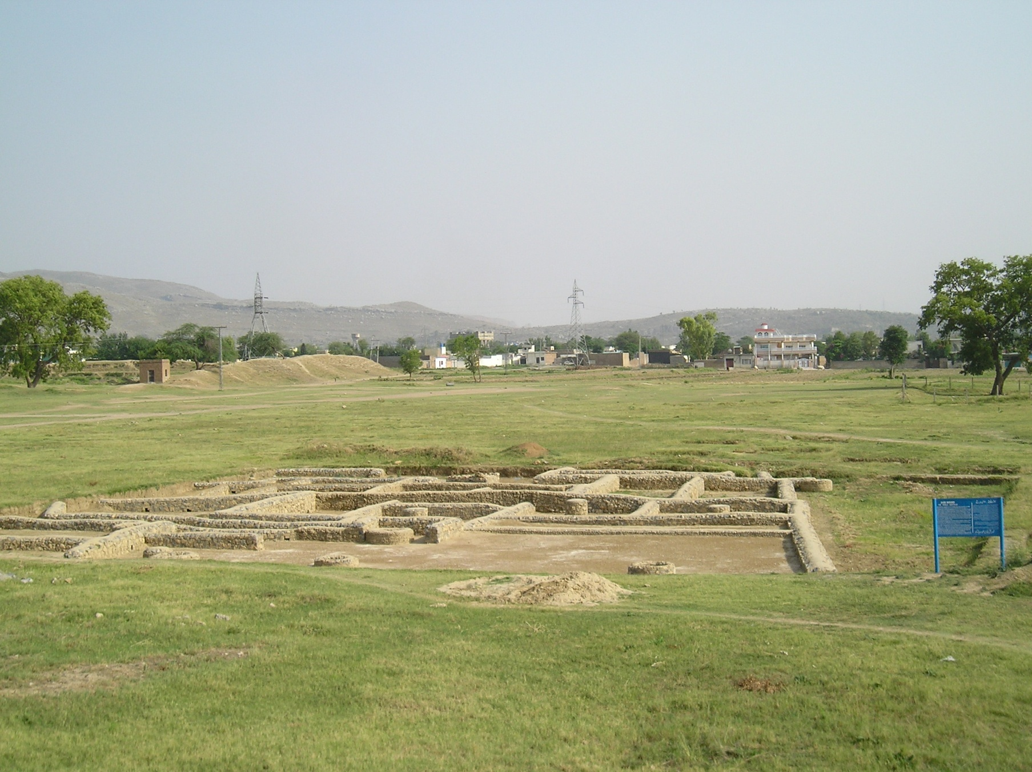
Bhir Mound the First City of Taxila Founded by Acamenians of Persia in 600 BC.

Slide 23
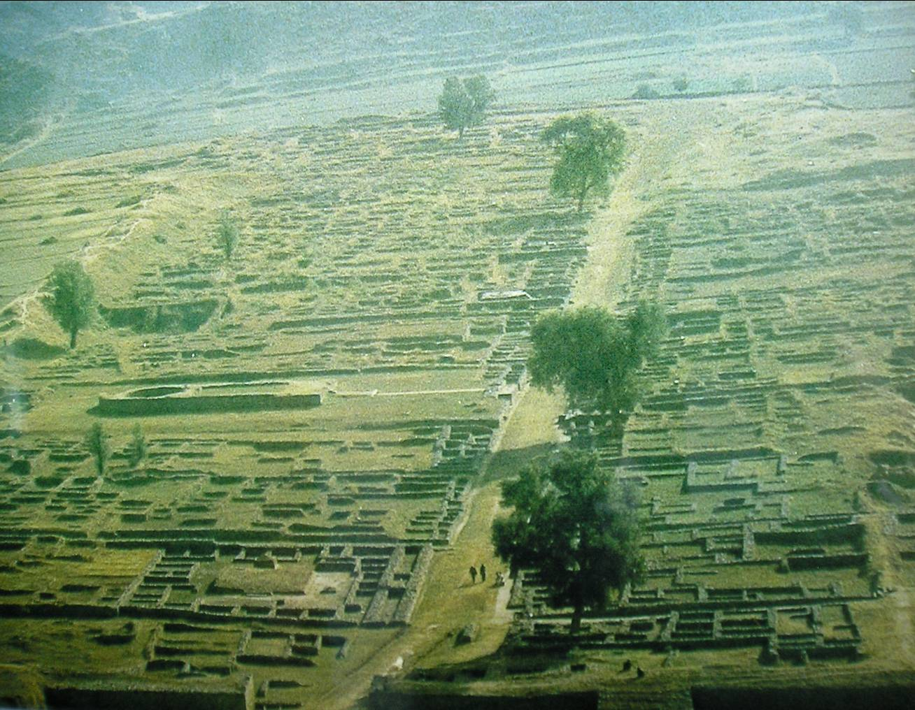
Sirkap the Second Capital City of Taxila founded by Indo-Greeks in 200 BC.

Slide 24
Sirsukh, the third Capital City of Taxila Founded by Kushans in 200 AD.

Slide 25
Temples, Monasteries and Stupas

Slide 26
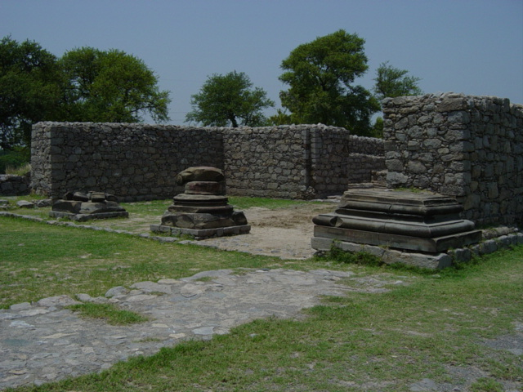
Jandial Temple (2nd Century BC.)

Slide 27
Dharmarajika Stupa, Taxila,
Founded by Ashoka in 3rd Century BC.

Slide 28
Dharmarajika Stupa, Taxila,
Founded by Ashoka in 3rd Century BC.

Slide 29
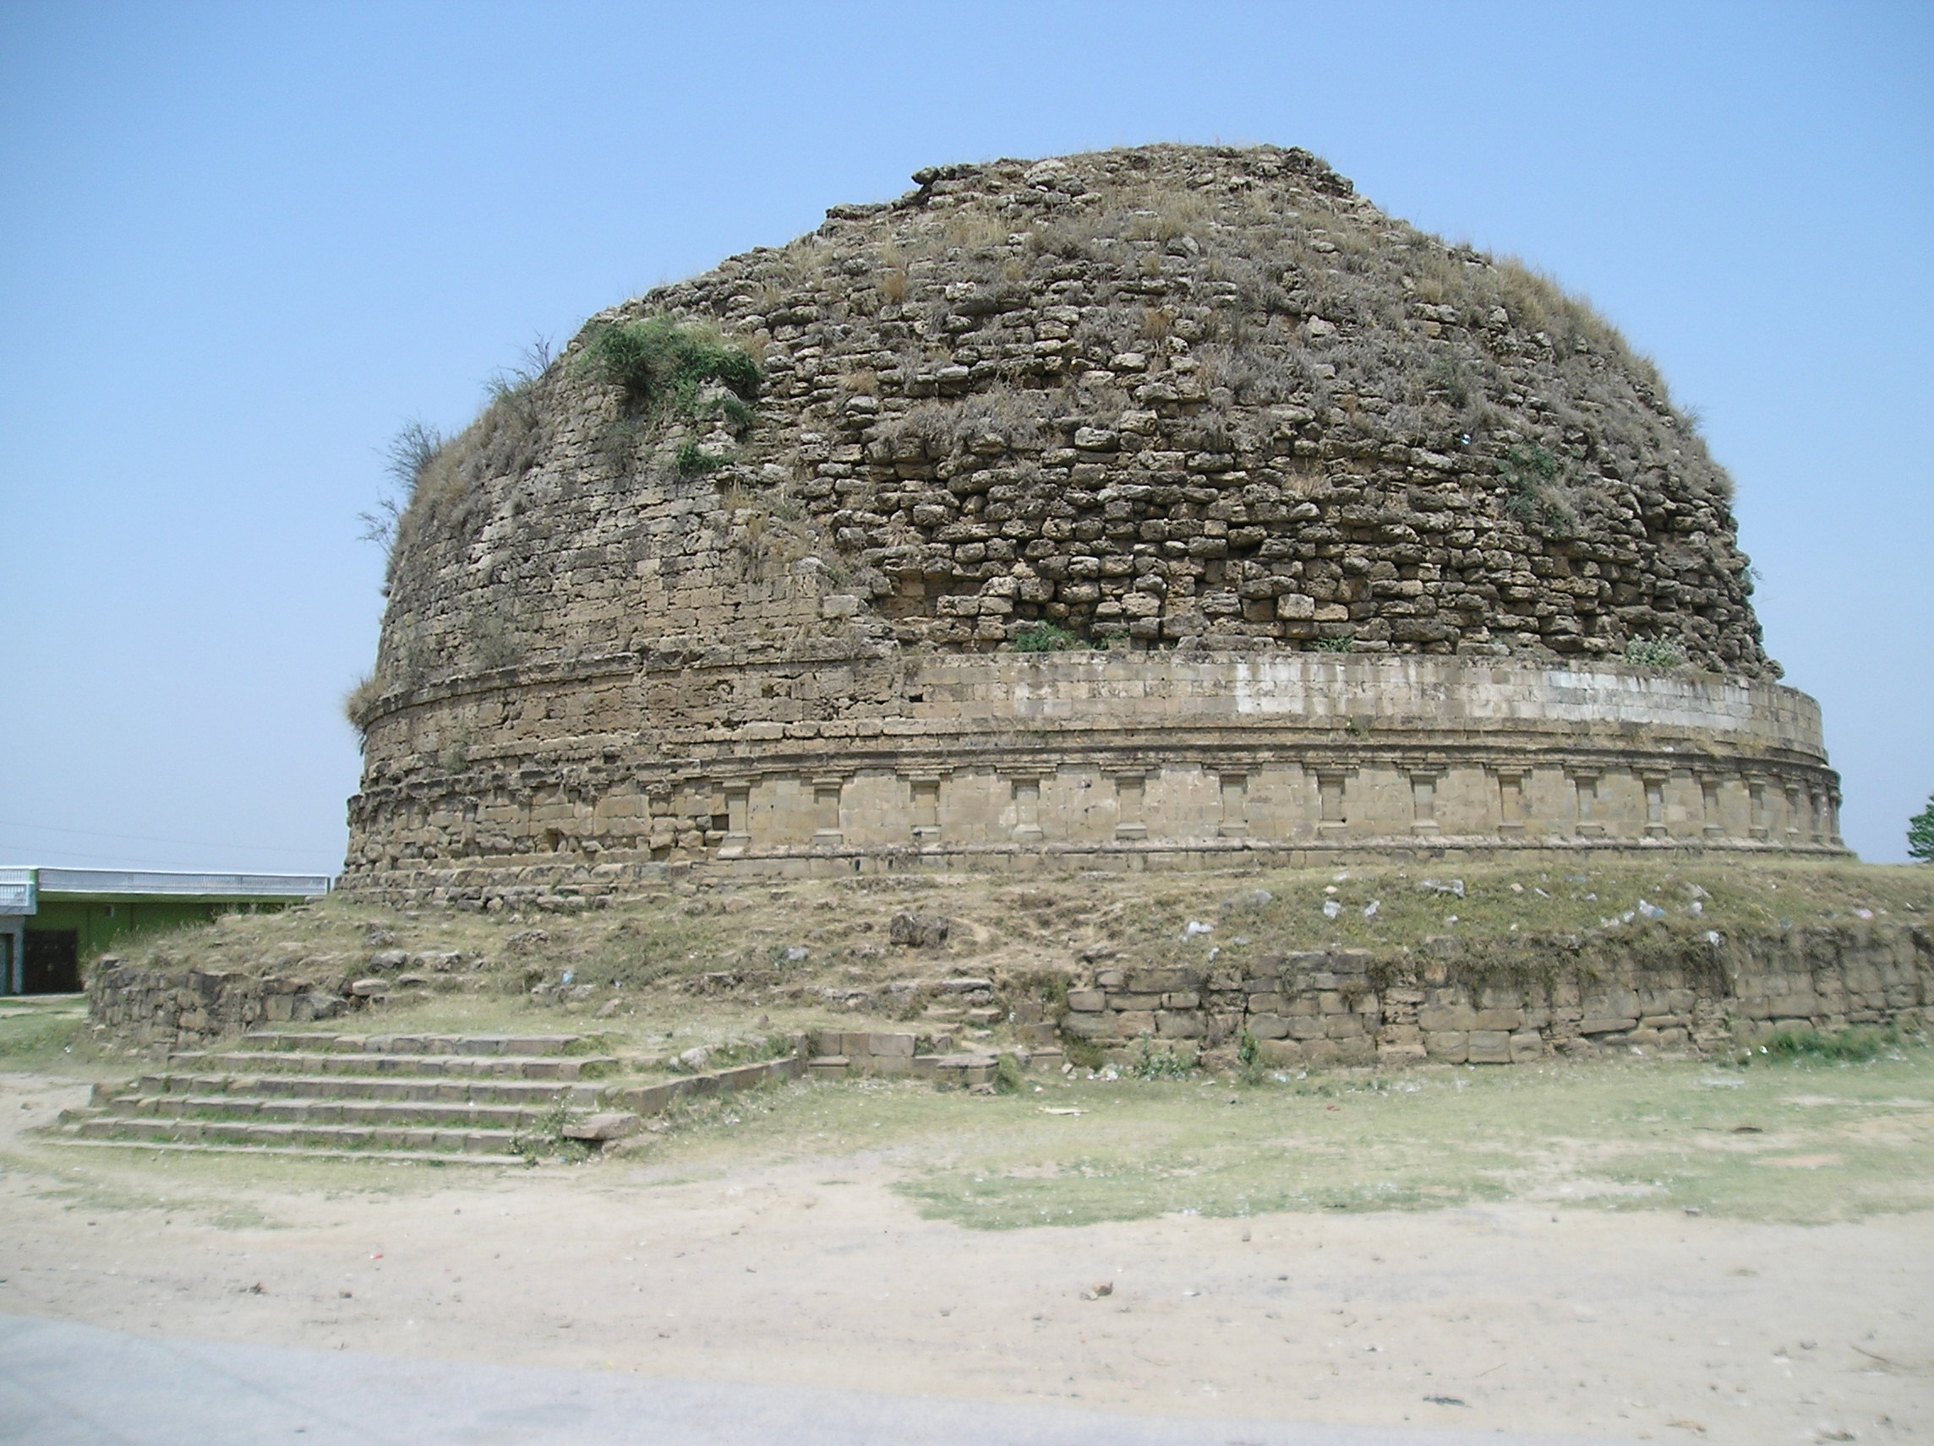
Mankiala Stupa near Rawat (Rawalpindi)
Founded by Ashoka in 3rd Century BC.

Slide 30
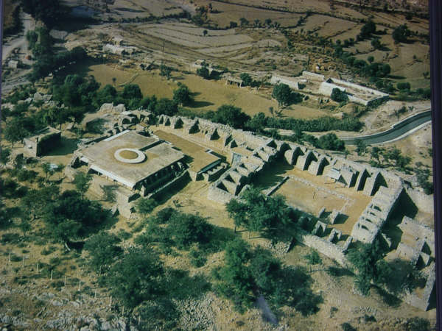
Jaulian Monastery, Taxila
(2nd-5th Century AD.)

Slide 31
Kunala Stupa, Taxila Founded by Ashoka
in 3rd Century BC.

Slide 32
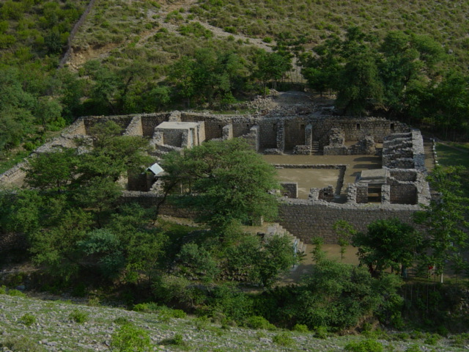
Mohra Moradu Monastery, Taxila
Kushan Period (200-500 AD.)

Slide 33
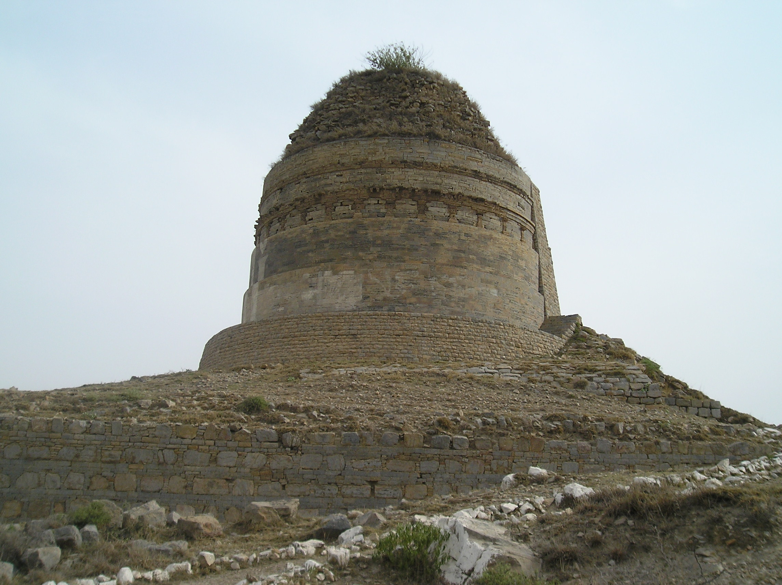
Bhallar Top Stupa, Taxila, Kushan Period
(2nd - 5th Century AD.)

Slide 34
Bhamala Stupa, Taxila
(4th-6th Century AD.)

Slide 36
Butkara Stupa, Saidu Sharif
(3rd Century BC-5th Century AD.)

Slide 37
Shingar Dar Stupa, Swat
(3rd Century BC - 5th Century AD.)

Slide 39
Asoka Rock Edicts, Mansehra

Slide 40
Jaba Rock Painting, Mansehra

Slide 41
Khalyala Rock Paintings, Mansehra

Slide 42
Kani Gati Rock paintings, Lassan Thakral, Mansehra

Slide 43
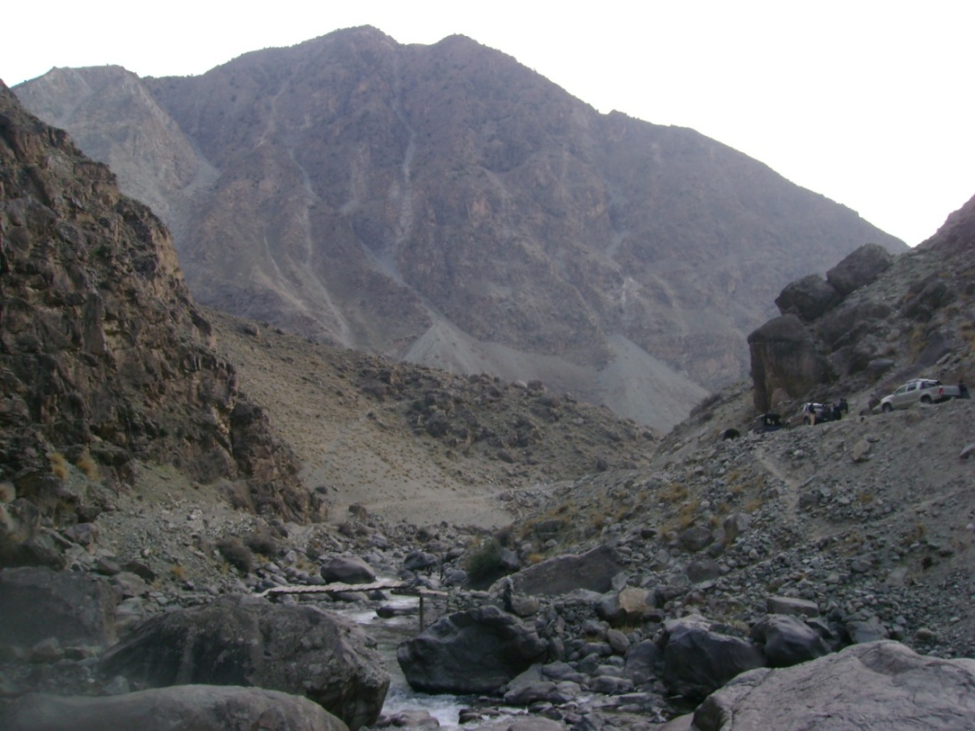
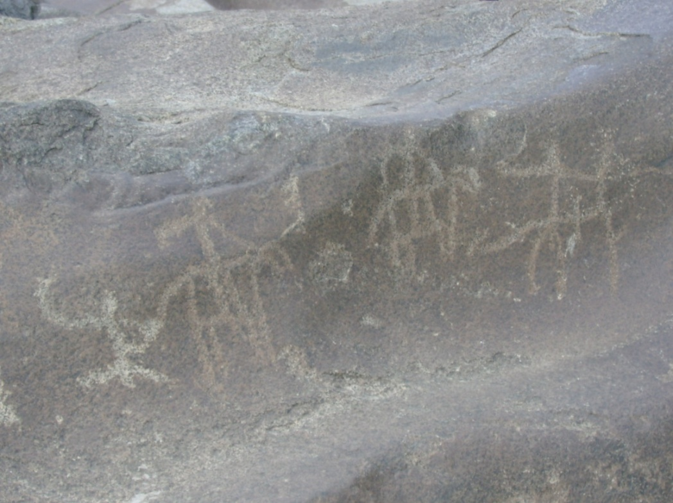
Darial Rock Carvings, Dasu

Slide 44
New Discoveries in Gandhara
Jinnan Wali Dheri
Taxila

Slide 45
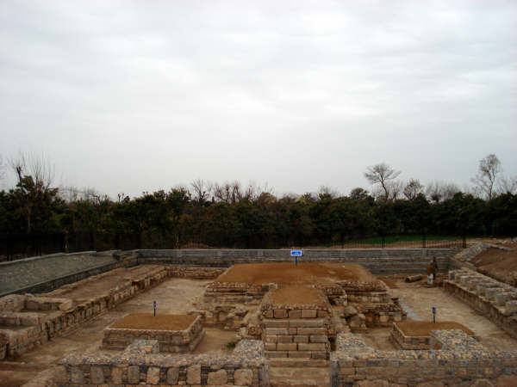
Stupa of Jinan Wali Dheri, Taxila(2nd - 5th Century AD.)

Slide 46
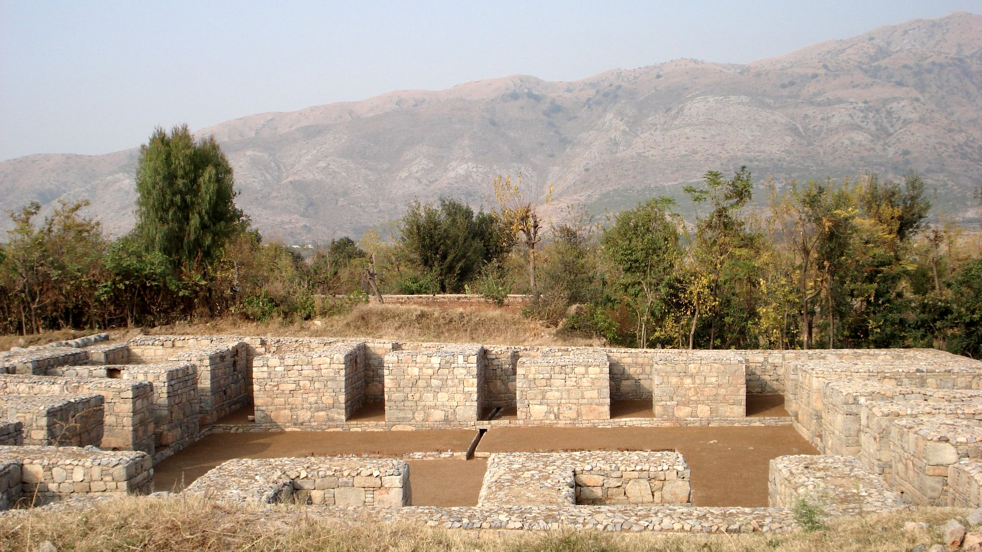
Buddhist Monastery, Jinan Wali Dheri, Taxila (2nd-5th Century AD.)

Slide 47
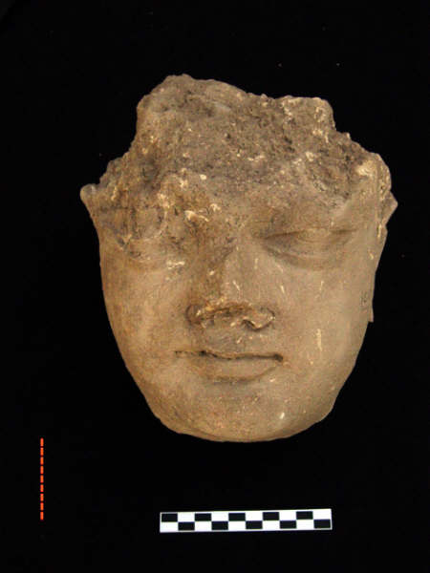
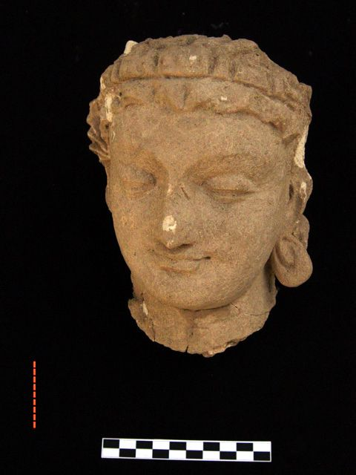
Buddha heads

Slide 48
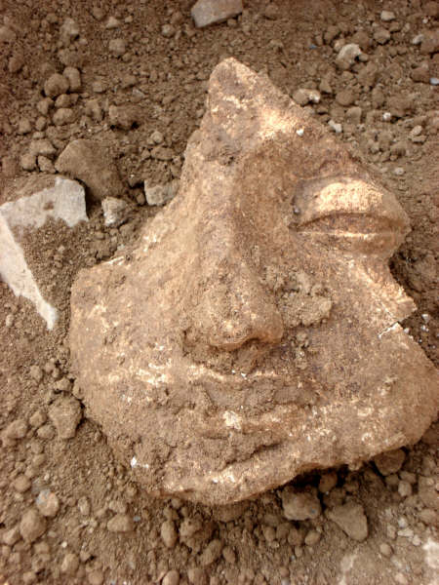
Buddha head

Slide 49
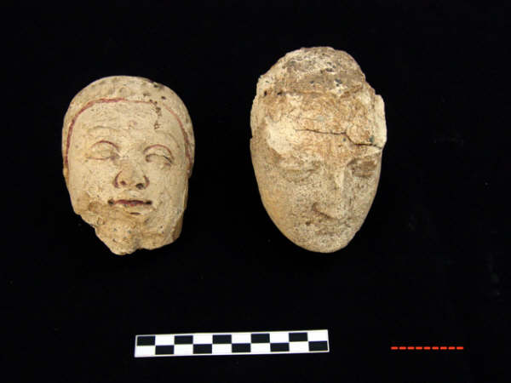
Buddha head

Slide 50
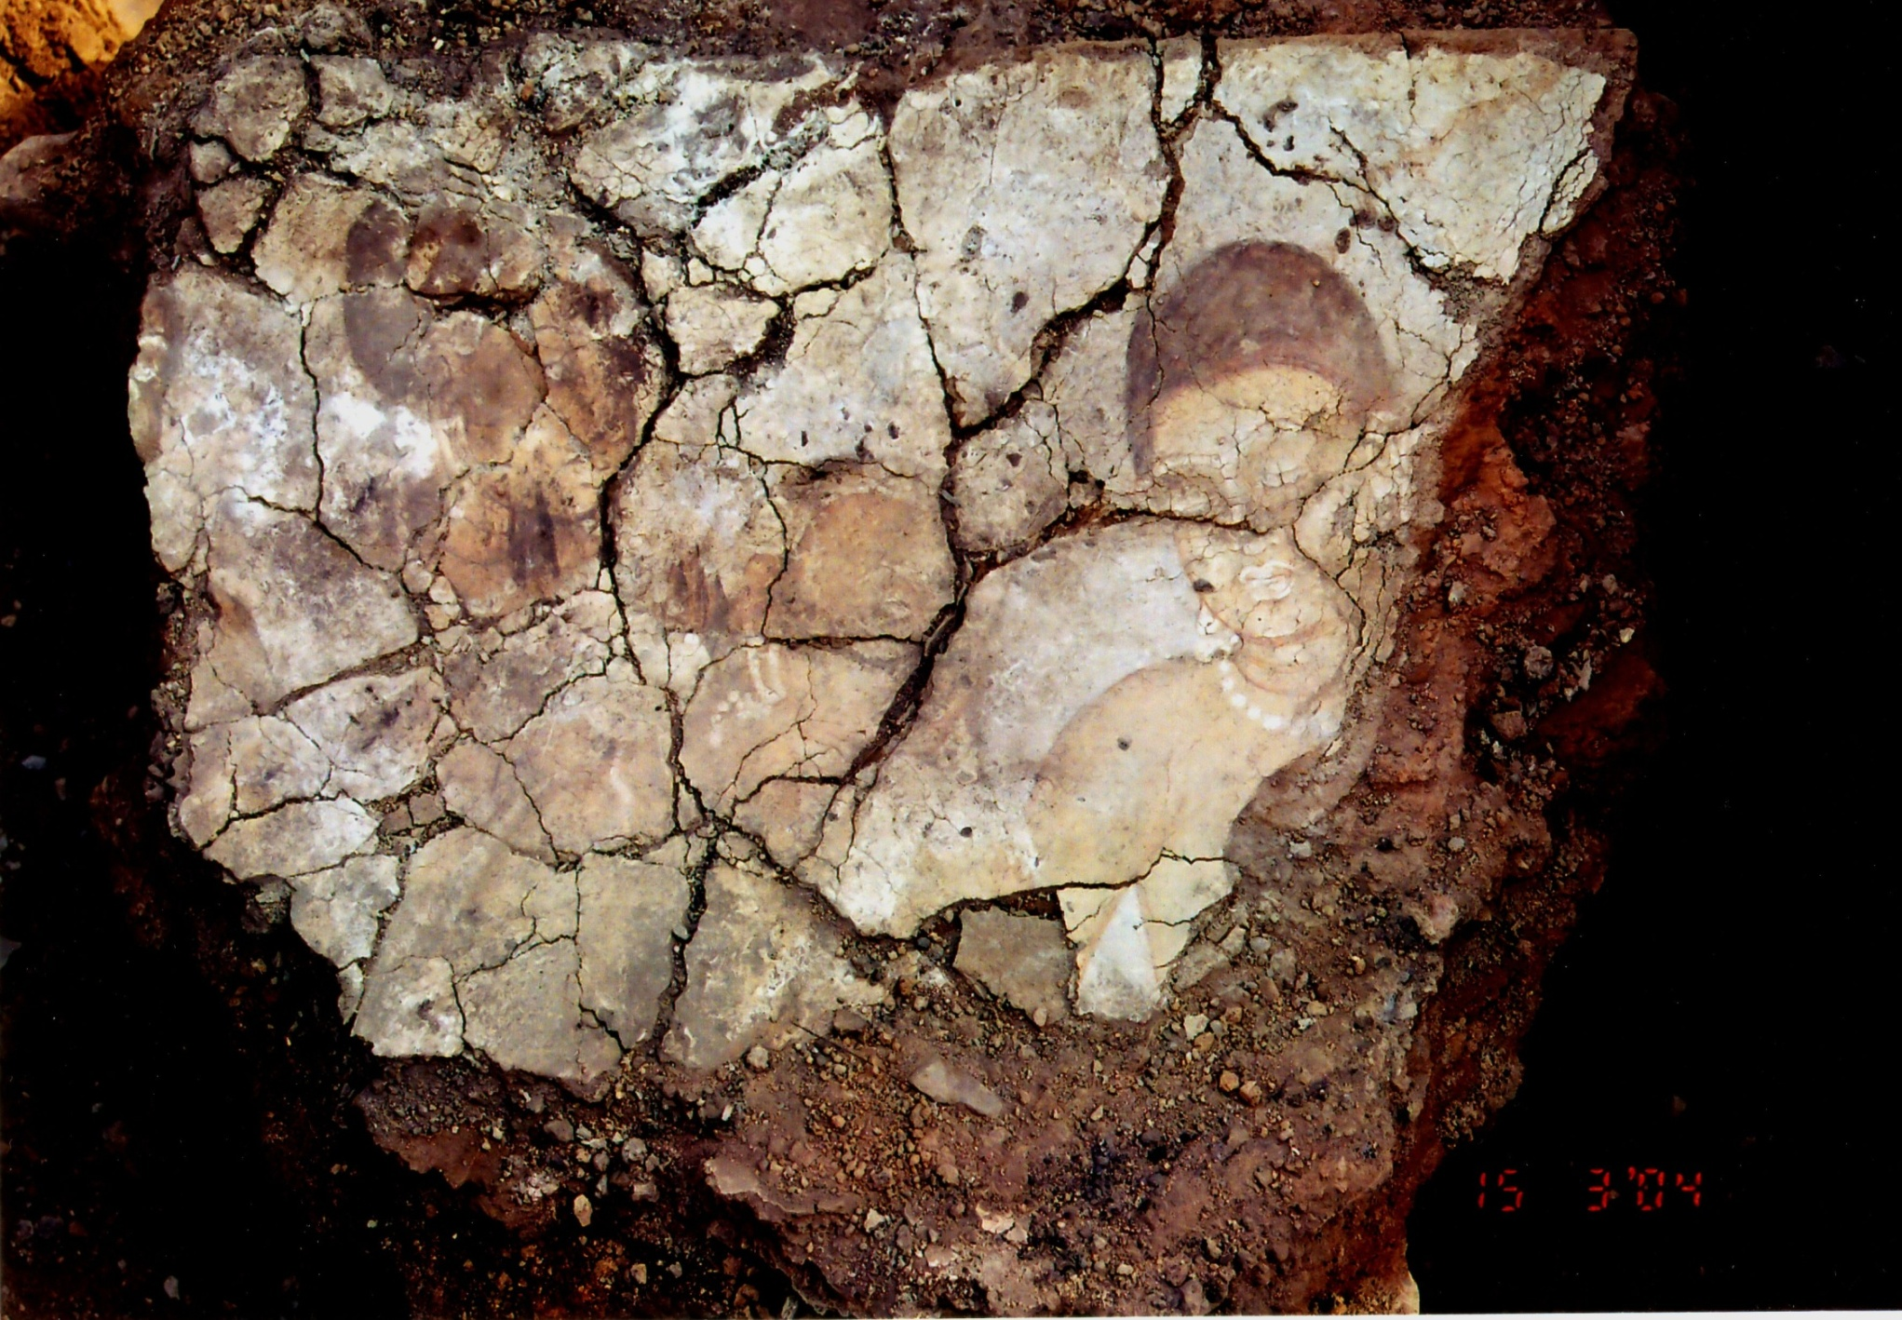
Buddhist Painting

Slide 51
COIN of Shah Poor-II, 3rd Century AD

Slide 52
Coins from Jinnan Wali Dheri Taxila

Slide 53
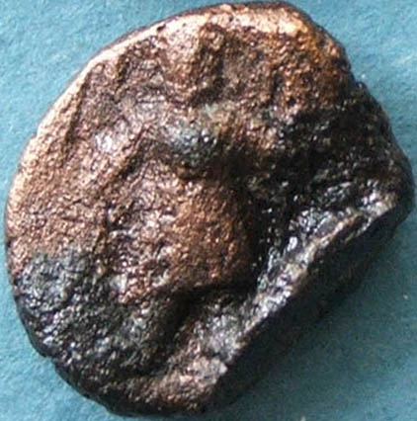
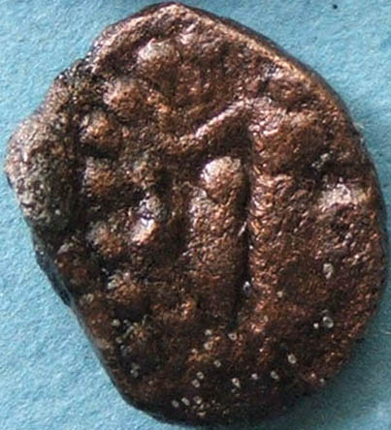
Vasudave-I

Slide 54
Grinding mill with Swastika and Khorushti Inscriptions

Slide 55
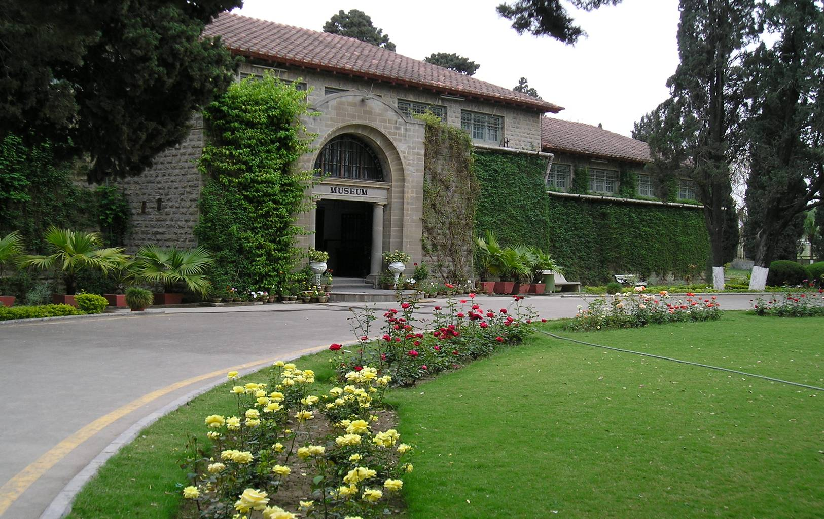
Taxila Museum (1928)

Slide 56
Dream of Maya

Slide 57
Birth of Lord Buddha

Slide 58
Bath of Lord Buddha

Slide 59
Birth Scene

Slide 60
Birth Scene

Slide 61
Birth Scene

Slide 62
Bath Scene

Slide 63
Renouncing the household lofe

Slide 64
Departure and Mara’s temptation

Slide 65
Attack of Mara and his army

Slide 66
Mergence of the four bowls

Slide 67
Lord Buddha in the Fire temple

Slide 68
Miracles at Saravasti

Slide 69
Miracles at Sravasti

Slide 70
Lord Buddha preaching at Trayastrimsa

Slide 71
Back to human world

Slide 72
Thank You!

Slide 73
Your Topic Goes Here
Your subtopics go here

Slide 74
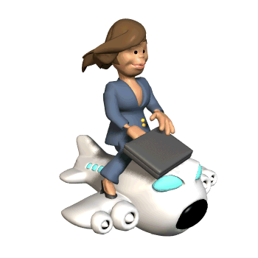
Elements
www.animationfactory.com
Use this Fuzzy Box to:
Soften the edges of animations.
Scale to any size.

